Slide 1
1 2 3 4 5 6 7 8 9 10 11 12
The numbers 1-12 naturally form four groups
First Principles: 1, 2
Numbers of Structure: 3, 4, 6, 8, 12
Numbers of Life: 5, 10
Numbers of Mystery: 7, 9, 11
Michael S. Schneider
www.constructingtheuniverse.com

Slide 2
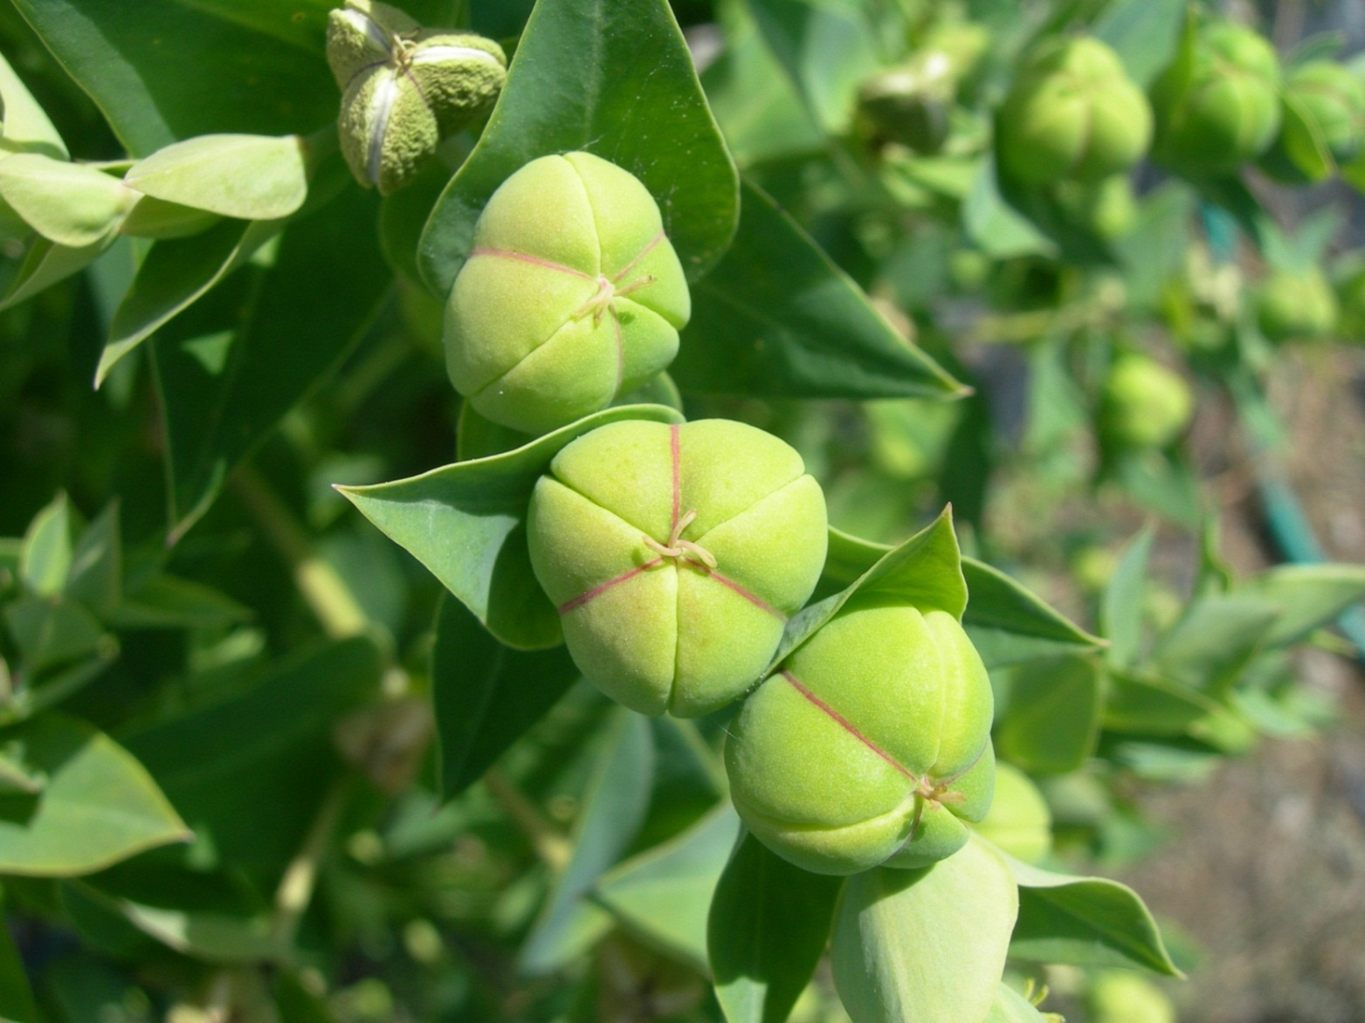
Ad Triangulum Symmetry
1 2 3 4 5 6 7 8 9 10 11 12
Numbers of Structure

Slide 3
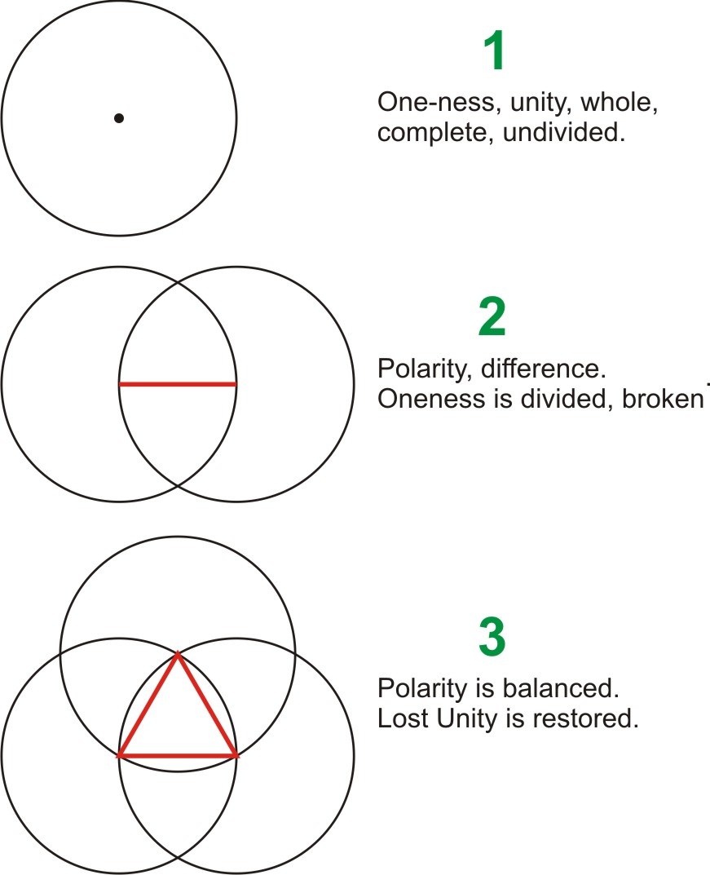
The third makes a new whole and brings the opposites to a new level they couldn’t achieve by themselves.

Slide 4
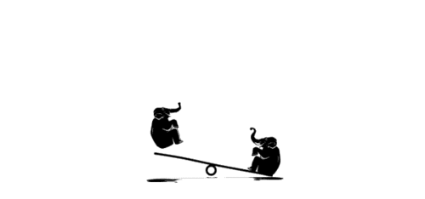
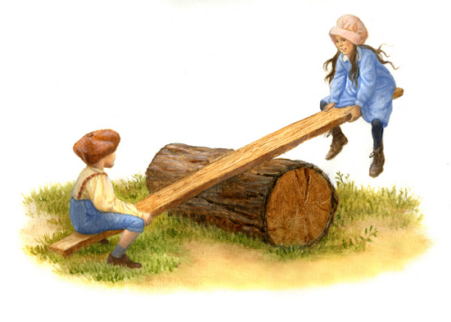
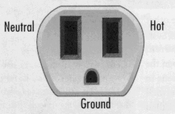
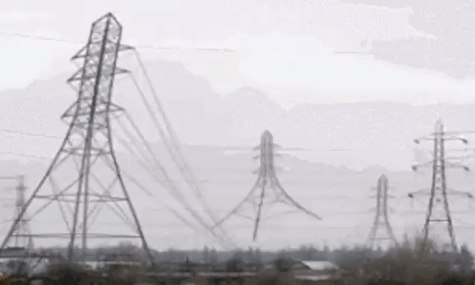
The Third balances a Polarity,
taking opposites to a new level
they couldn’t achieve by themselves.
Polarity
Neutral Judge
- Defense
Polarity
+ Prosecution

Slide 5
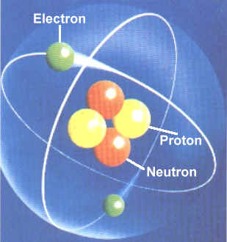
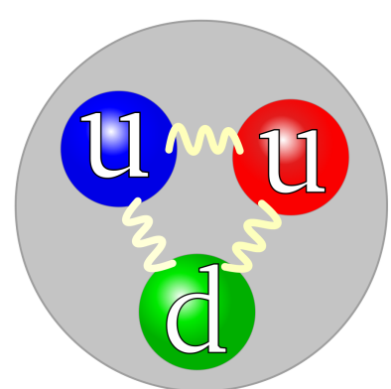
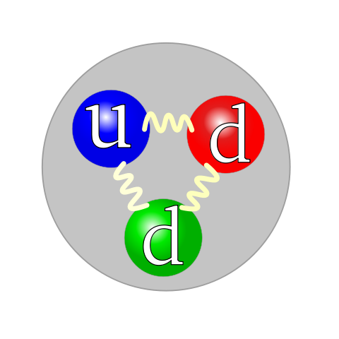
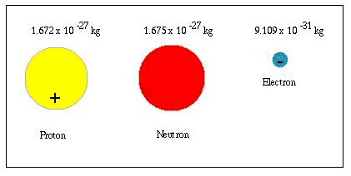
All Atoms (beyond Hydrogen) have 3 parts
Neutron & Proton: 3 quarks each
Helium
-
+
The Neutron balances the opposites

Slide 6
Three Primary Colors
of Light and Pigment
RGB add to white
CMY(K) subtract to black

Slide 7
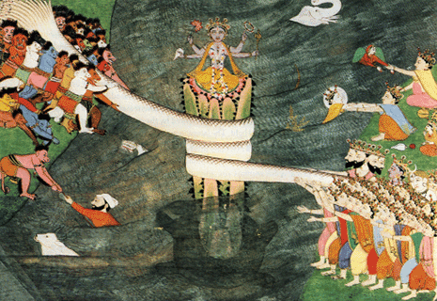
A balance of polarity creates the universe in mythology.
Asuras (demons)
Vishnu
Devas (angels)
Dvi- = shining
Divine, devil
Tug-of-war polarity churns the cosmic milk producing the universe.

Slide 8
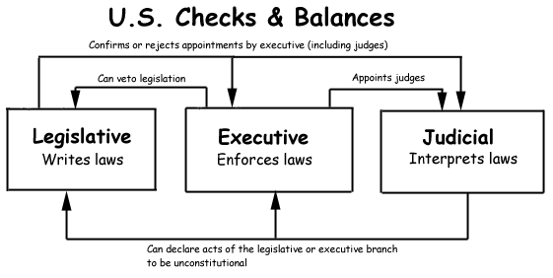
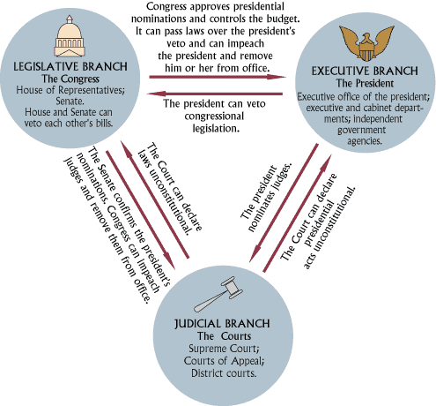
Structure of the U.S. Government
Polarity
3rd : neutral balance

Slide 9
“We hold these Truths to be self-evident, that all Men are created equal, that they are endowed by their Creator with certain unalienable Rights, that among these are
Life, Liberty and the Pursuit of Happiness.”
– Declaration of Independence
YOUR PURSUIT OF HAPPINESS
An ongoing balance
LIFE
What we have to do
Polarity
LIBERTY
What we want to do
“There is no path to happiness - happiness is the path.” -- Buddha
Homework: Illustrate how you balance
Life and Liberty in your own life

Slide 10
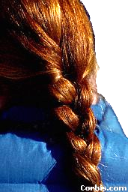
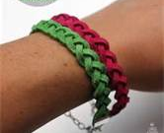
Braids: 3 strands become one whole
an ongoing
3-strand knot
Trinity = Tri-Unity
3 become as 1
a three part unity, a threefold oneness Complete. Whole.
Balanced. Strong.

Slide 11
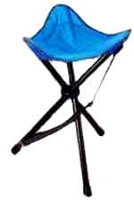
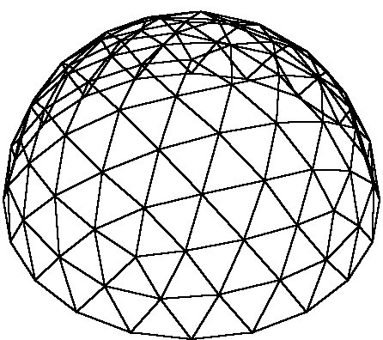
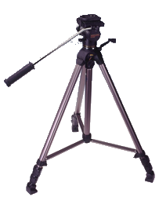
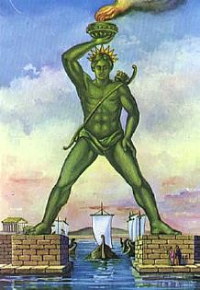
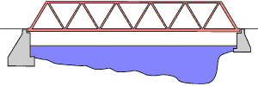
A triangle is the strongest, most stable shape in two dimensions.
Geodesic Dome
Truss Bridge

Slide 12
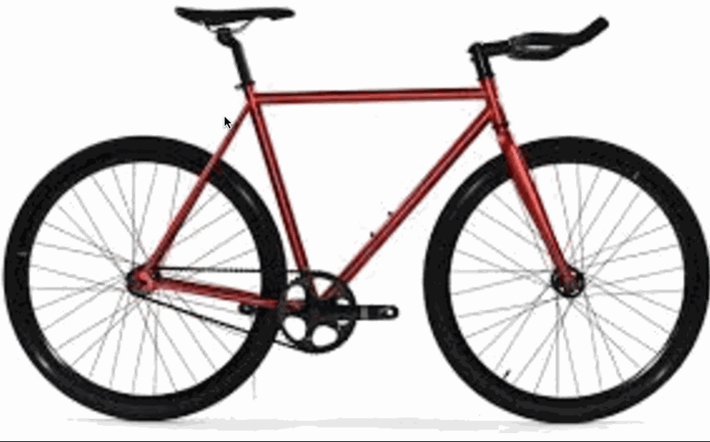
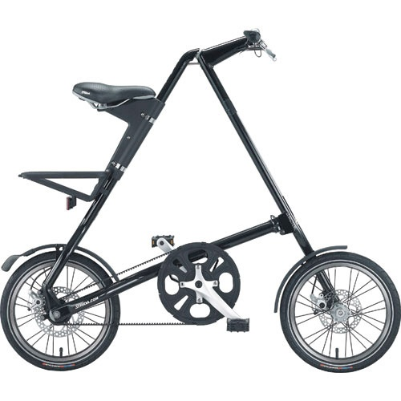
Variations of the same principles

Slide 13
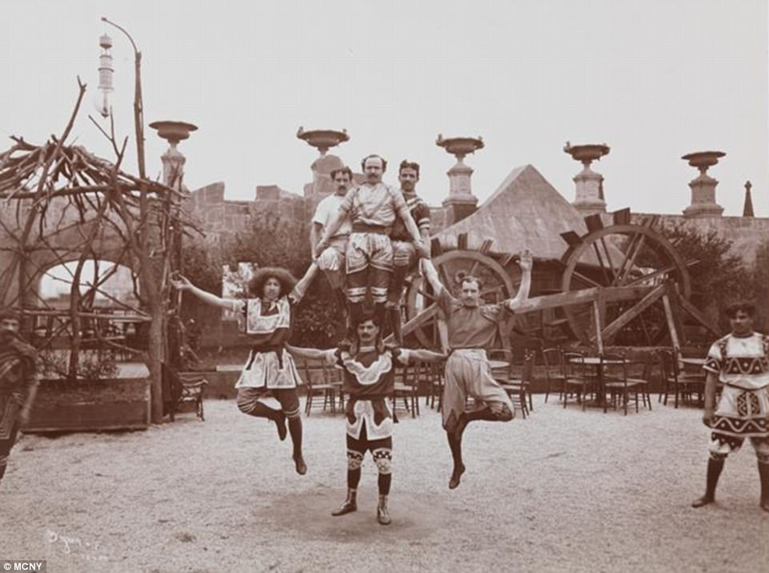
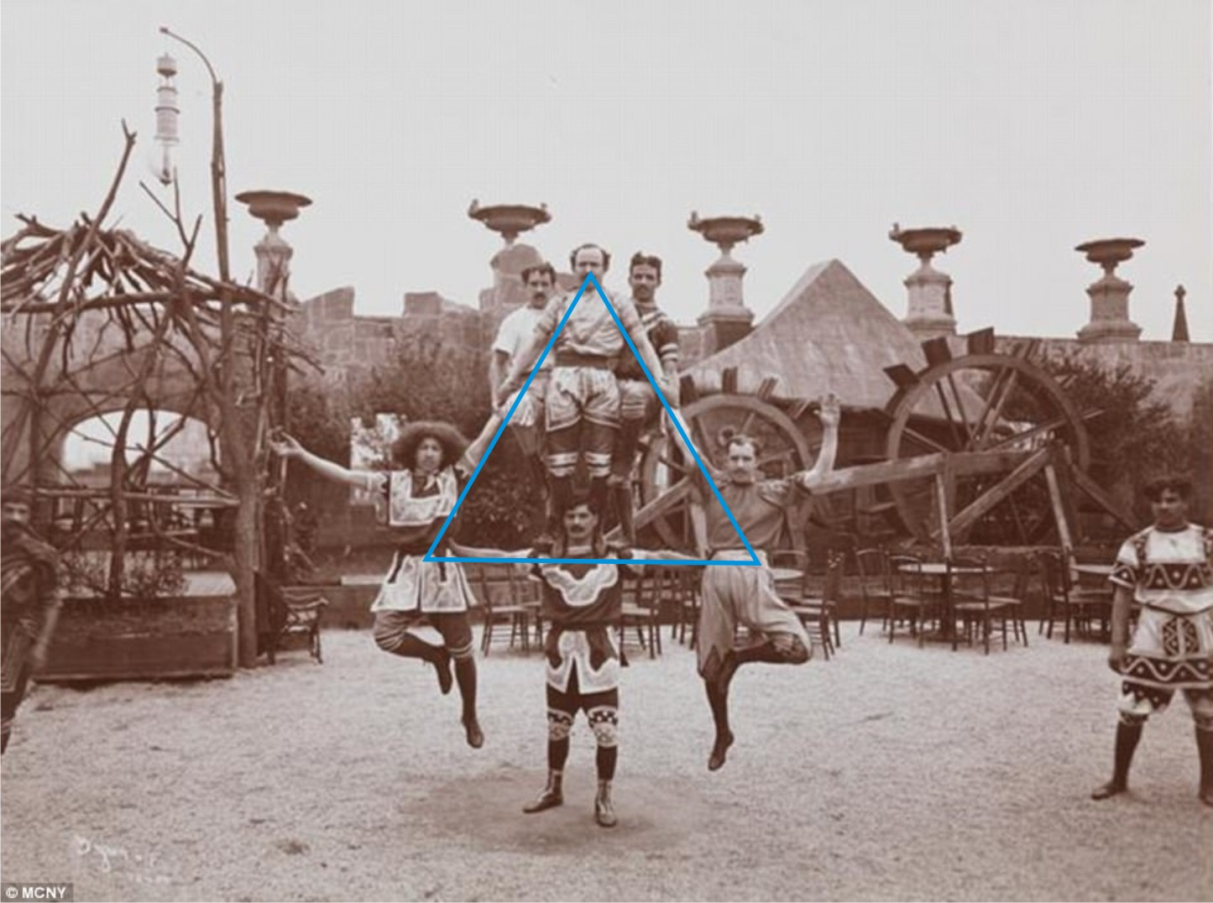

Slide 14
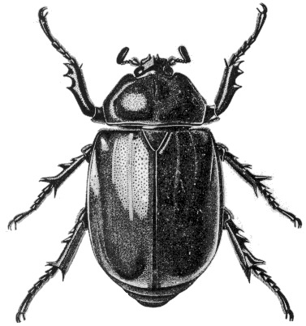
Triangular Stability
All insects have 3 sections and 6 legs.
They walk on three legs at a time, always on a stable tripod.

Slide 15
Triangular Stability

Slide 16
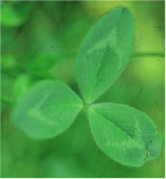
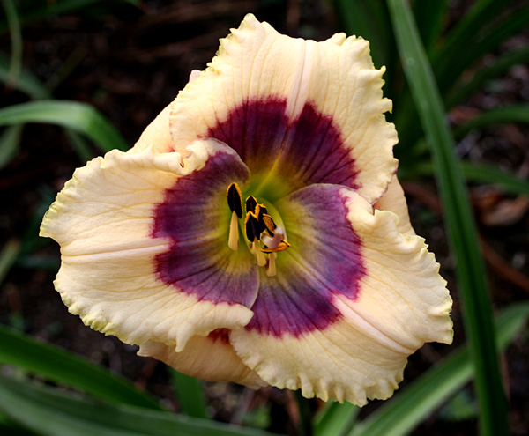
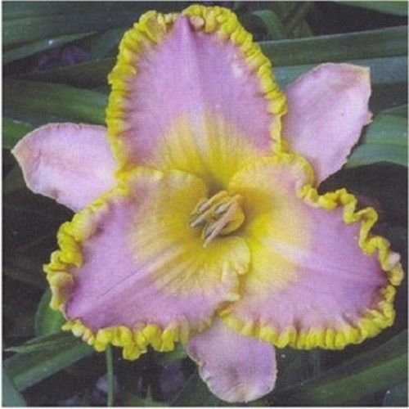
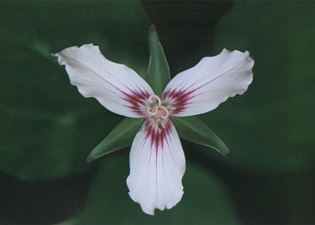
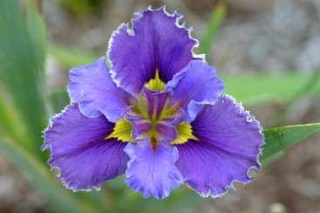

Slide 17
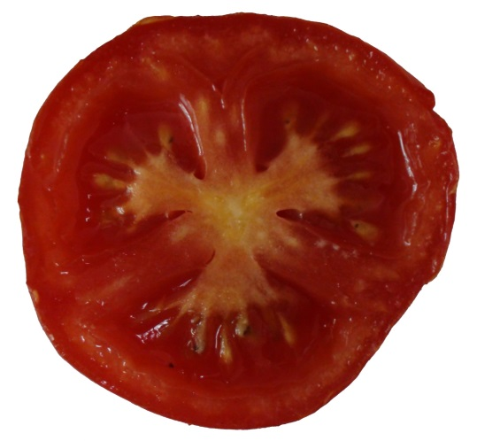
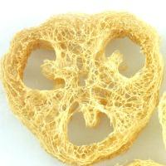
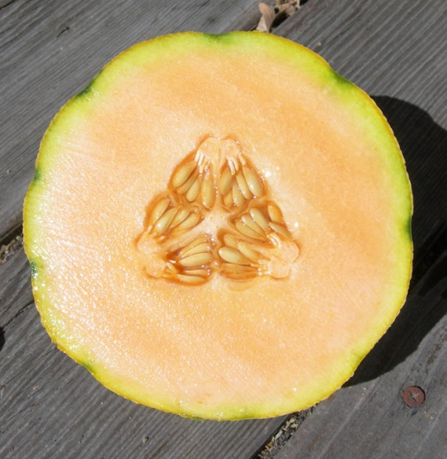
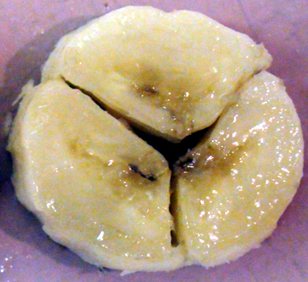
3 demonstrates strong and balanced structure, and efficient packaging.

Slide 18
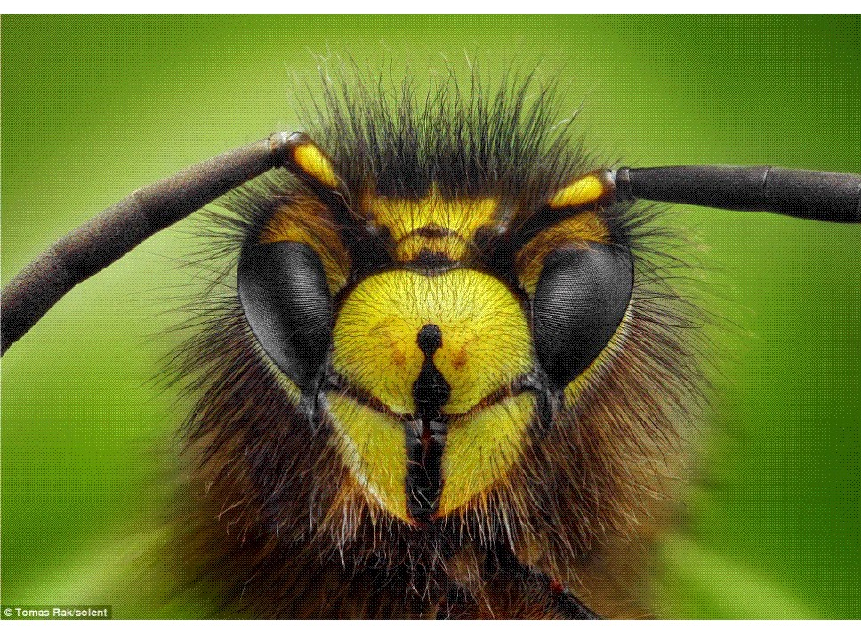

Slide 19
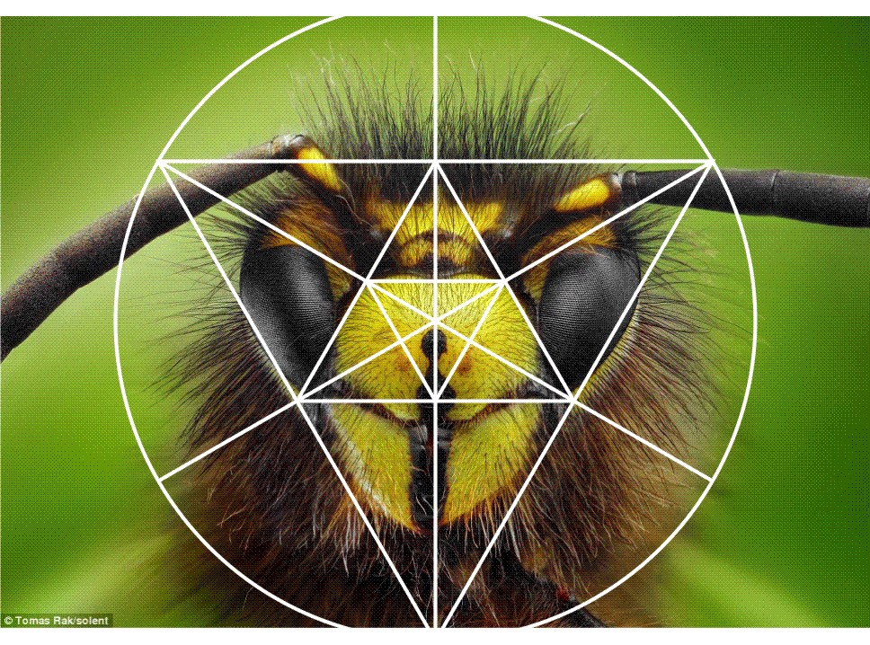
Insect forms are based on the numbers 3 & 6 and the geometry of the triangle

Slide 20
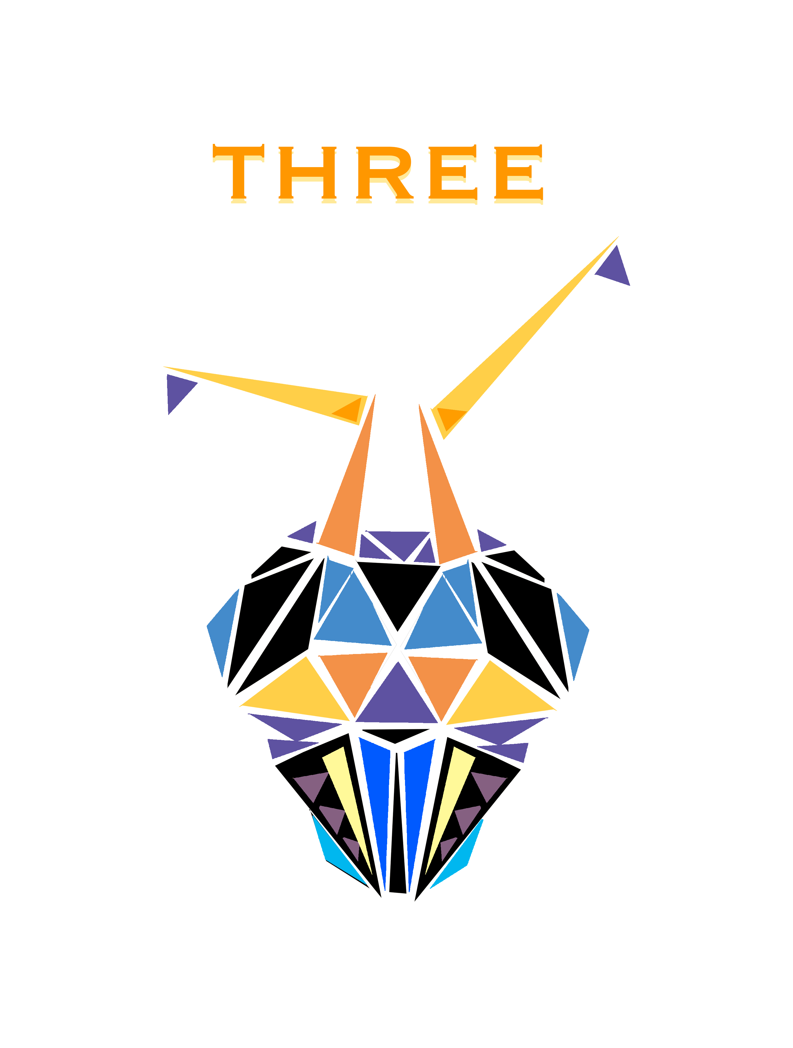
Page 35

Slide 21
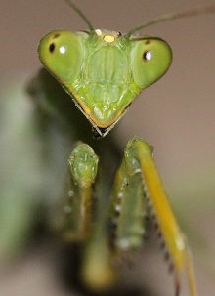
Triangles?
What triangles?
I don’t see any triangles!

Slide 22
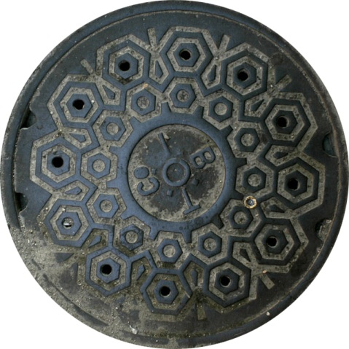
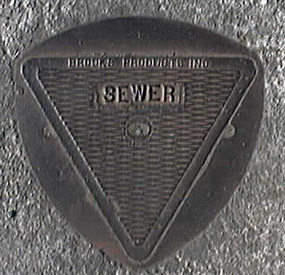
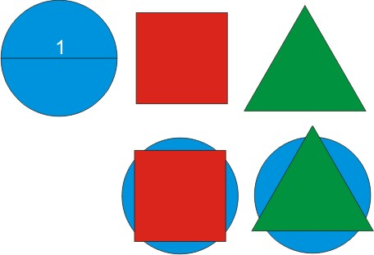
A Triangle is the Opposite of a Circle
When they have the same distance around they have different areas:
Circle the Most, Triangle the Least
Areas = .785
.617
.475
The tips beyond the circle won’t fill in the blue areas.

Slide 23
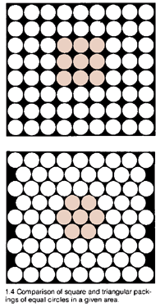
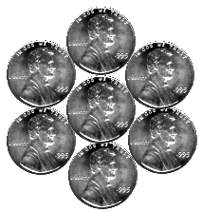
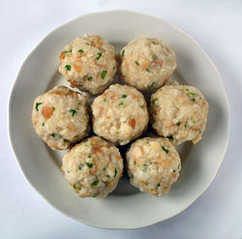
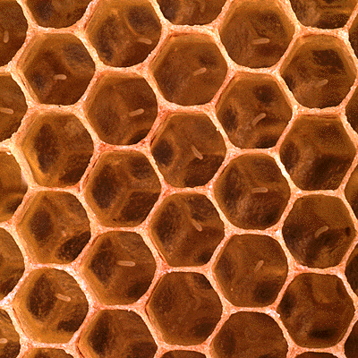
Page 30
8-around-1
Square
Six is superior for Close-Packing
72
6-around-1 Hexagon (Triangles) Getting more in the same space.
77

Slide 24
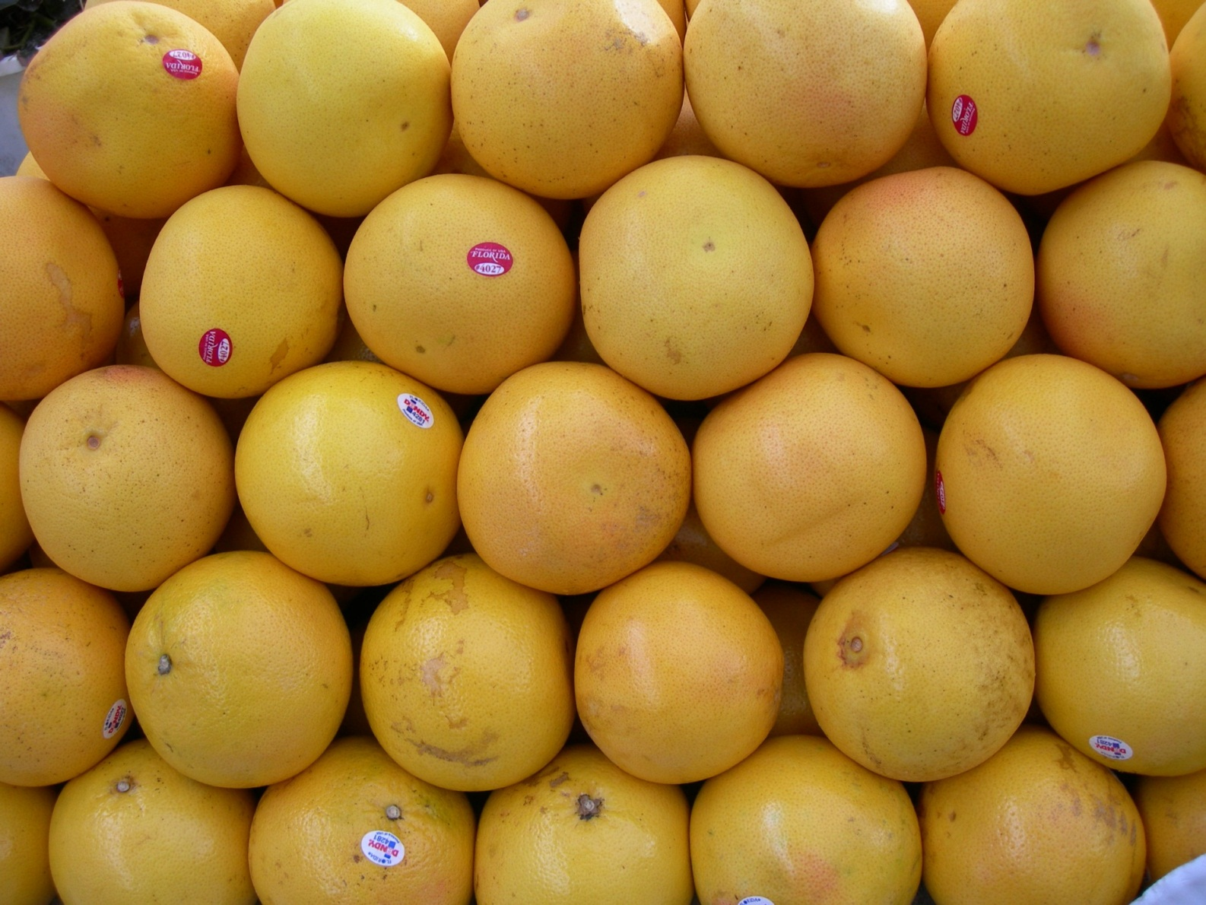
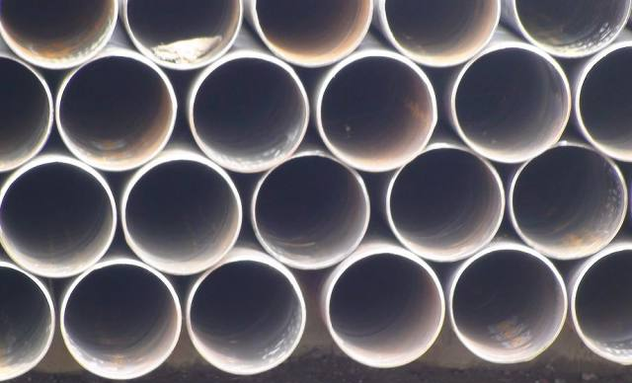
Six around One
Close-packed and stable

Slide 25
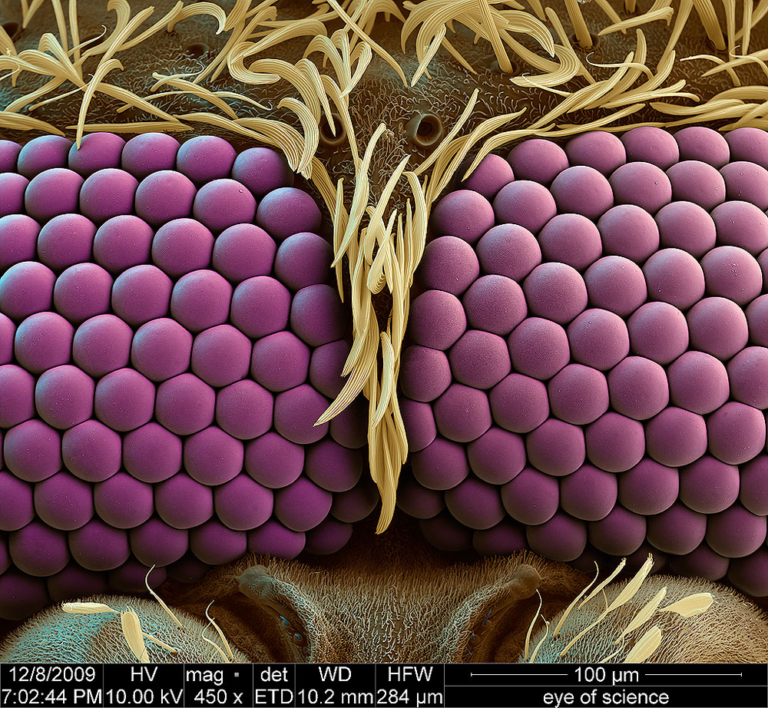
What is it?
Mosquito eyes
(and a hip haircut)

Slide 26
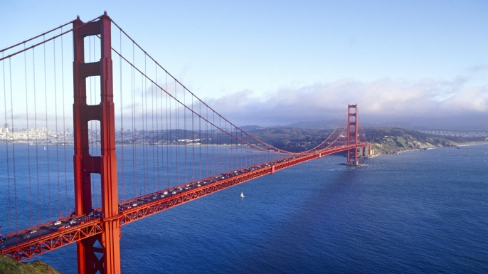
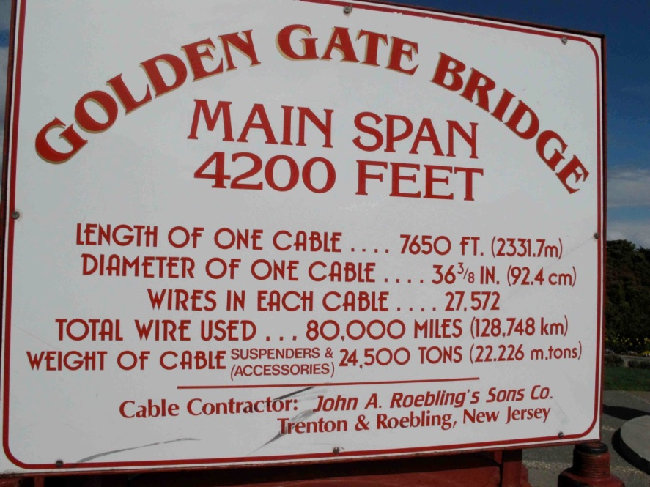
Hexagonal Cable structure

Slide 27
Six in Design
6 approximates a circle using straight lines

Slide 28
Kaleidocycle
Enlarge and use stiffer paper
Page 37

Slide 29
Page 31
1: “Walk” the radius around the circle (in both directions).
2: Draw a circle and diameter. Turn the compass around and make an arc from each end.

Slide 30
1: “Walk” the radius around the circle.

Slide 31
1: “Walk” the radius around the circle.

Slide 39
2nd method: Turn a circle …

Slide 40
Draw any diameter.
Polarity has been introduced.

Slide 41
Make an arc from each end of the diameter.

Slide 42
Make an arc from each end of the diameter.
If you did this accurately, you’ve now got 6 equally-spaced points around the circle.

Slide 43
Connect the 6 points to make a hexagon

Slide 44
Connect the 6 points internally (as two triangles) to make a hexagram

Slide 45
Keep connecting every new set of 6 points…

Slide 46
Reproduce these geometric constructions directly upon the pictures
Page 32
If possible, use a colored pencil

Slide 47
Page 33
In each, first find the two points to place your compass.

Slide 48
Page 34
Design some snowflakes
Design your own crest

Slide 54
Design a beautiful snowflake …
Or design your own personal seal.

Slide 56
Page 28

Slide 57
Page 29

Slide 58
Ideas for homework?
Busby Berkeley (choreographer)

Slide 60
Page 38
All very minimal

Slide 61
Kaleidoscope

Slide 62
Grinning Monkey Orchids
Grow at high elevations in the forests of Columbia, Ecuador and Peru

